Slide 1



Amazon Review Data Analysis
Digital Music and Musical Instrument

Slide 2
Table of content
Glimpse of Data
Business Objective
EDA (Exploratory Data Analysis)
Sentiment Analysis
Time Series Analysis

Slide 3



Data Dictionary
The Dataset Contains the following Features
Reviewer ID : Unique ID of each review
Asin : Unique Product Id
Rating : Ratings for the Products given by Reviewer
Review Time : Time of Review
Main Category : Category
Review Text : Reviewer opinion regarding the Product
Summary : Brief Statement of the Review Text
Verified : Boolean Data (Yes/No)
Brand : Brand of Particular Product

Slide 4
Business Objective
To Classify the reviews into particular categories based on different sentiments
To identify top brand and Genre enjoyed by the customers by clustering techniques
To recommend likeable content to the customers by forecasting

Slide 5
EDA (Exploratory Data Analyses) using tableau

Slide 6
Work flow of review Categorization
Data Cleaning
Data Preprocessing, feature Selection
Tokenization
&
Lemmatization
Text Preprocessing , NLP , NLTK
Sentiments (Polarity Score)
Sentiments score using TextBlob
Review categorization
Sentiment Analysis

Slide 7
Analysis of Reviews
Input Text | Decisive Words from the text | Sentiments
This is awesome to listen to, A must-have for all fans..sadly needed to be a triple disc set..They have so many hits!! | Awesome , needed | Positive
It was great to hear the old stuff again and I like the new stuff too. I recommend it to any Slayer fan.SLAYER | Great , new , fan , recommend | Positive
Never had caviar before... Shouldn't have started with cheap stuff but hate to buy expensive and possibly not like it | Cheap , hate , expensive | Negative
poor quality ,came wrapped in tapepoor quality, came wrapped in | Poor | Negative

Slide 8
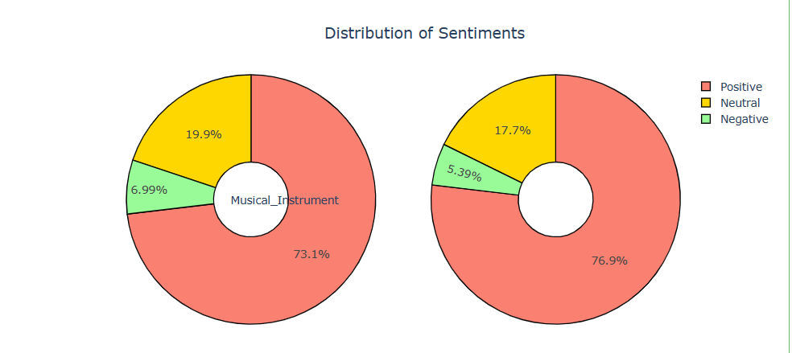
Sentiment Analysis
Musical Instrument
Digital Music
Digital_Music

Slide 9
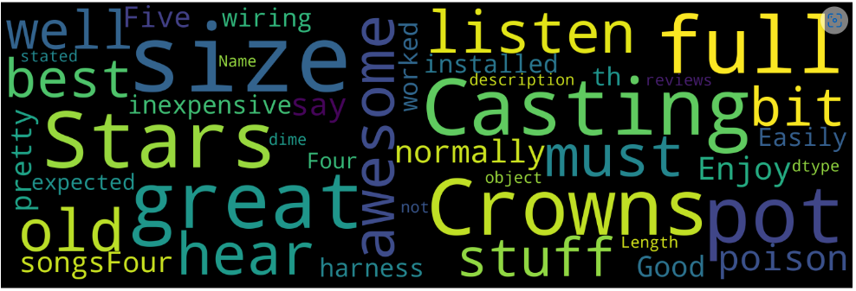
Word cloud of positive sentiments
Positive Words
Great
Well
Best
Awesome
Dime
Enjoy
Worked
Good
Inexpensive

Slide 10
Comparison of Classification Algorithms
Models | Classes | F1-score | Precision | Recall | Accuracy
Logistic Regression | Negative Neutral Positive | 0.91 0.90 0.93 | 0.93 0.90 0.90 | 0.95 0.91 0.87 | 92%
MultinomialNB | Negative Neutral Positive | 0.93 0.82 0.97 | 0.93 0.89 0.87 | 0.94 0.97 0.79 | 90%
Decision Tree Classifier | Negative Neutral Positive | 0.88 0.86 0.89 | 0.89 0.87 0.87 | 0.91 0.87 0.85 | 87%

Slide 11
Clurstering
Algorithms | Silhouette Score
KMeans | 30.5%
Agglomerative | 34.9%
DBSCAN | 34.2%

Slide 12
Clusters Obtained
Clusters Formed | Brands/Artist | Insights
Average | Yamaha , Gator | These Brands has lower rating , lower Polarity Score
Good | Levy's Leathers , Musically | These Brands has comparatively good rating
Best | Fender , JIM DUNLOP , D'Addario Accessories | These Brands has Best rating and Feedback among others

Slide 13


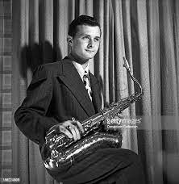
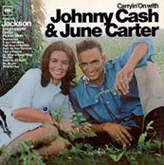
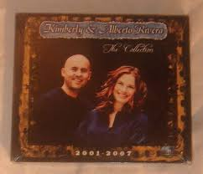


Highly Recommended category with Price
Stan Gertz
Price: $183.97
June Carter & Johnny Cash
Price: $168
Kimberly and Alberto Rivera
Price: $165
Paul English
Price: $135
101 StringOrchestra
Price:$99

Slide 14
Work flow of Product Forecasting
Resample the data quarterly
1
Check for trend and seasonality
2
Build multiple models
3
Select the best model
4
Forecast the trend
5

Slide 15
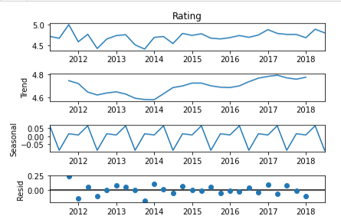
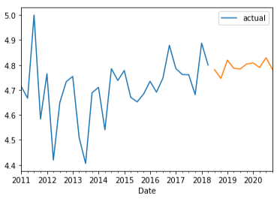
Forecasting Highly Recommended Brand from Musical Instrument
Brand – D’Addario
Data decomposition
Sarima
Rating
We can see Positive trend for D’Addario

Slide 16
Forecasting Highly Recommended Brand from Digital Music
Data decomposition
Sarima
Rating

Slide 17
B0002H05BA
Data decomposition
Rating

Slide 18
Conclusion
After observing the sentiments of reviews, we found that most of the reviews are positive
Almost all the categories have verified customers, hence the reviews are genuine and trustworthy
Even though the price of positively reviewed products is not low as compared to the negatively reviewed products, customers liked them because of the quality.

Slide 19

Thank you
Flora@contoso.com
http://www.contoso.com/

